Slide 1

Segmentation of Bladder Lesions and Detecting Level of Invasion using Mask R-CNN
Muhammed Göktepe, Erencan Uysal
Advisors: Pınar Yanardağ, Suzan Üsküdarlı
Notes:
Hi. Welcome to our project presentation. Our topic is Segmentation of Bladder Lesions and Detecting Level of Invasion using Mask R-CNN

Slide 2
Motivations
The bladder is a hollow muscular organ in your lower abdomen that stores urine.
Bladder Cancer is the 10th most common malignancy worldwide.
549,000 new cases and 200,000 deaths in 2018.
The 2-, 5, and 10-year recurrence rates were 61.1%, 69.5%, and 74.3%.
Notes:
Bladder cancer is the tenth most common malignancy worldwide. there were half million new cases and two hundred thousands deaths in two thousand eighteen. Bladder cancer has higher recurrence rates compared to other cancer types.

Slide 3
Aims
With this project, we wanted to assist radiologists by segmenting MR images.
We segmented DWI MRI’s using Mask RCNN.
We tried to develop a method for automatized VI-RADS scoring.
Our work can support radiologists in VI-RADS scoring of MRI’s of Bladder Cancers.

Slide 4
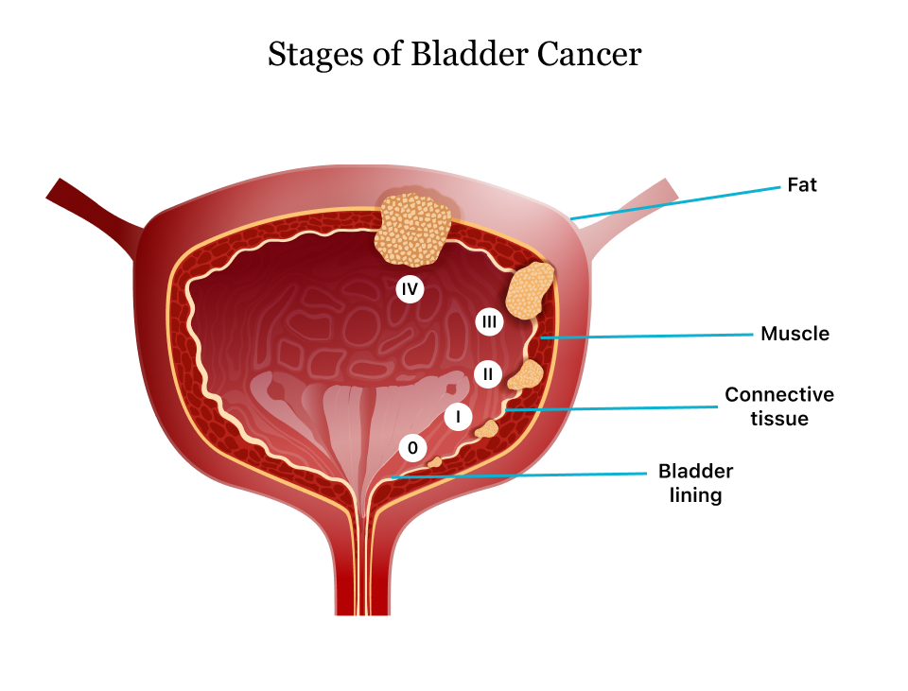
Bladder Cancer
The bladder wall contains three main layers: the innermost mucosa, the muscularis propria , and the outermost serosa with perivesical fat.
In the earliest stages the cancer has not invaded into the main muscle wall of the bladder.
In Stage II, cancer has spread to the muscle wall of the bladder.
In Stage III, the cancer has spread to the fatty tissue outside the bladder muscle.
In Stage IV, the cancer has metastasized from the bladder to the lymph nodes or to other organs or bones.
Notes:
Bladder wall contains three main layers. in the earliest stages, the cancer has not invaded into the main muscle wall of the bladder.
in stage two, cancer has spread to the muscle wall of the bladder.
In Stage III, the cancer has spread to the fatty tissue outside the bladder muscle.
In Stage IV, the cancer has metastasized from the bladder to the lymph nodes or to other organs or bones.

Slide 5
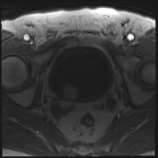
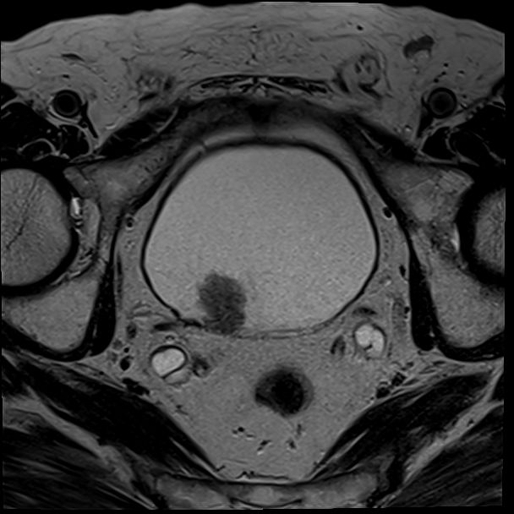
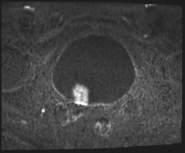
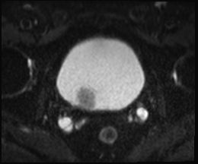
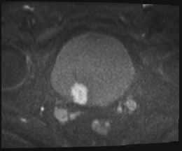
Magnetic Resonance Imaging
Magnetic Resonance Imaging (MRI) is a non-invasive imaging technology that produces three dimensional detailed anatomical images.
Multiparametric MRI (mpMRI) is method of trying to obtain an image by combining T2-weighted (T2WI), diffusion weighted (DWI), dynamic contrast enhanced (DCEI) and, if desired, MR spectroscopy (MRSI) images.
This method is usually used in the bladder and prostate imaging.
T1WI T2WI DWI ADCI DCEI
Notes:
Magnetic Resonance Imaging (MRI) is a non-invasive imaging technology.
Multiparametric MRI (mpMRI) is method of trying to obtain an image by combining T2-weighted (T2WI), diffusion weighted (DWI), dynamic contrast enhanced (DCEI) and, if desired, MR spectroscopy (MRSI) images.
This method is usually used in the bladder and prostate imaging.
We mainly focused on DWI scans in our project.

Slide 6
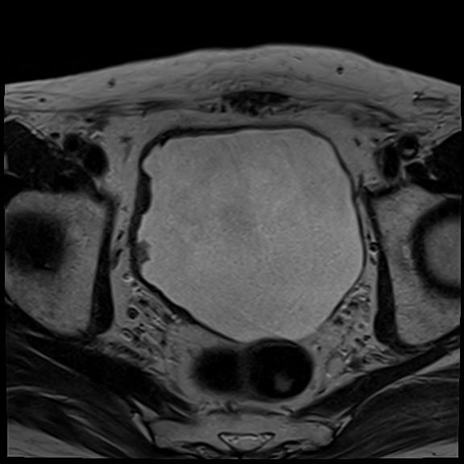
T2W Scans
T2W scans measure spin–spin relaxation by using long TR and TE times
Higher signal for more water content
Low signal for paramagnetic substances (like fat)
These scans generally used to make a first impression about lesions.
Tumors are visible in dark colors in T2W.
Notes:
In T2 weigheted scan higher signals shows more water content. Low signals show paramagnetic substances like fat.These scans generally used to make a first impression about lesions.
Tumors are visible in dark colors in T2W.

Slide 7
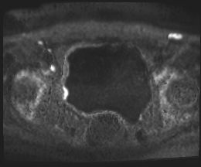
DWI Scans
It is a form of MR imaging based upon measuring the random Brownian motion of water molecules within a voxel of tissue.
Highly cellular tissues exhibit lower diffusion coefficients.
Cancer staging is made by evaluating the relationship of the bright parts seen in this sequence with the bladder wall.
Notes:
In diffusion weigheted ımaging scans, highly celular tissues exhibit lower diffusion coefficients which is the bright areas in the figure. Cancer staging is made by evaluating the relationship of the bright parts seen in this sequence with the bladder wall.

Slide 8
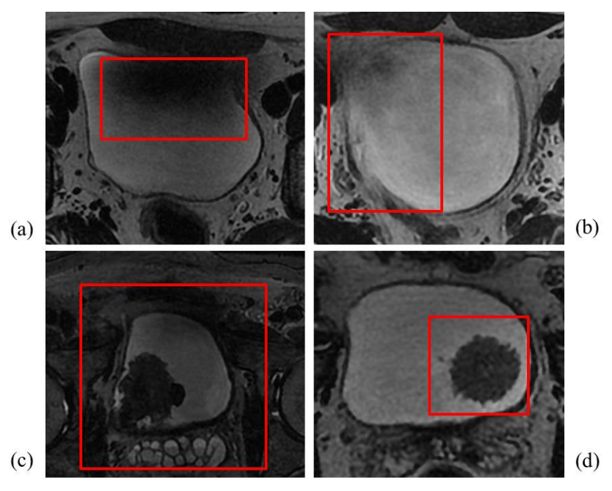
Challenges in MRI Segmentation
Challenges in computer-assisted segmentation of bladder MR images (highlighted in red boxes). Image regions in red boxes represent:
(a) intensity inhomogeneity in the lumen,
(b) weak wall boundaries,
(c) complex background intensity distribution,
(d) disconnected tumor region in the lumen, respectively.
Notes:
There are some challenges while segmenting bladder using MR images like intensity inhomogeneity in the lumen, weak wall boundaries, complex background intensity distribution and disconnected tumor region in the lumen.

Slide 9
VI-RADS Scoring
Structured reporting scheme for multiparametric bladder MRI in the evaluation of suspected bladder cancer.
Proposed by the European Association of Urology in 2018.
A combination of imaging findings - T2WI, DWI, and dynamic contrast enhancement predicts the probability of cancer that is clinically significant.
Notes:
Vı-rads scoring is a Structured reporting scheme for multiparametric bladder MRI in the evaluation of suspected bladder cancer. it is Proposed by the European Association of Urology in 2018. ıt uses T2Weigheted, Diffusion Weighted, and dynamic contrast enhancement techniques.

Slide 10
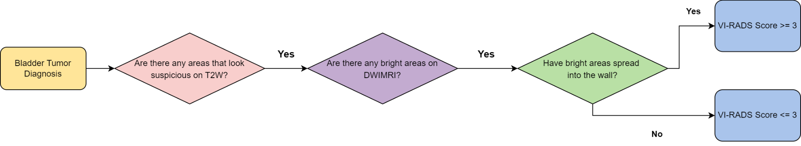
Diagnosis Steps
Notes:
We prepared a flowchart with the help of Dr. Rüştü Türkay from Bakırköy Training and Research Hospital. In diagnosis steps, radiologists generally examine T2W scans to find a tumor suspicion.
if they decide that a tumor is present, they will examine DW scans to detect the spread of the tumor. After this step, they decide the stage of the tumor.

Slide 11
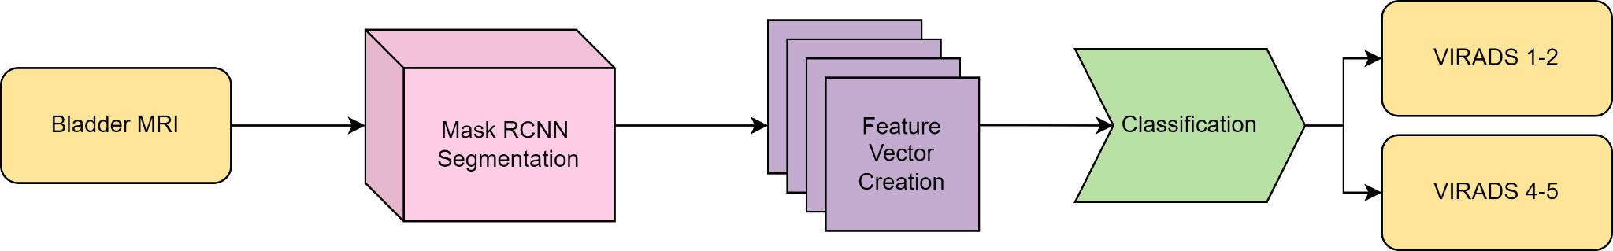
Our Methodology
Notes:
This flowchart represents our methodology.
In the first step, pretrained Mask R-CNN model fed with DWI MRI sequence.
After getting segmented images, necessary fields are calculated and summed up to derive volumes.
The resulting features are used with different classifiers. We implemented a rule-based unsupervised classifier which imitates the diagnosing steps of radiologists.
In the first stage, binary classification was used to increase the success due to the small dataset. After creating a larger dataset, multiclass classification can be used.

Slide 12
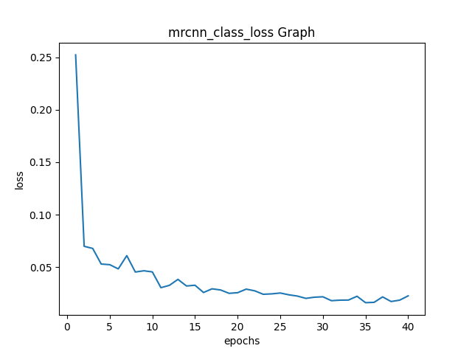
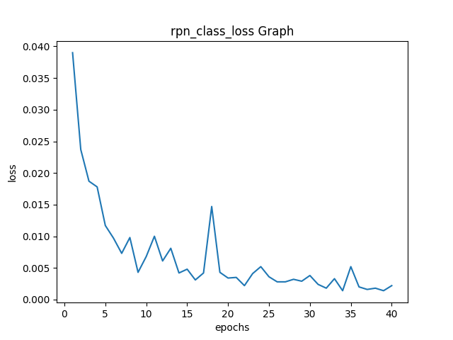
Segmentation of DWI Scans
We used Mask RCNN for segmenting outer wall, inner wall and lesions in bladder.
We used 40 epochs, all layers and 100 steps per epoch for training step.
Our training dataset has 1226 DWI from 50 different patients.
We used five-fold cross validation, thus we used all of these patients in testing.
* Classification losses reflect how confident the model is when predicting the class labels, or in other words, how close the model is to predicting the correct class.
Notes:
We used Mask RCNN for segmenting walls of the bladder and lesions in Diffusion weighted images.
We used 40 epochs, all layers and 100 steps per epoch for training step.
Our training dataset has 1226 T2W images from 50 different patients.
We used five-fold cross validation, thus we used all of these patients in testing.

Slide 13
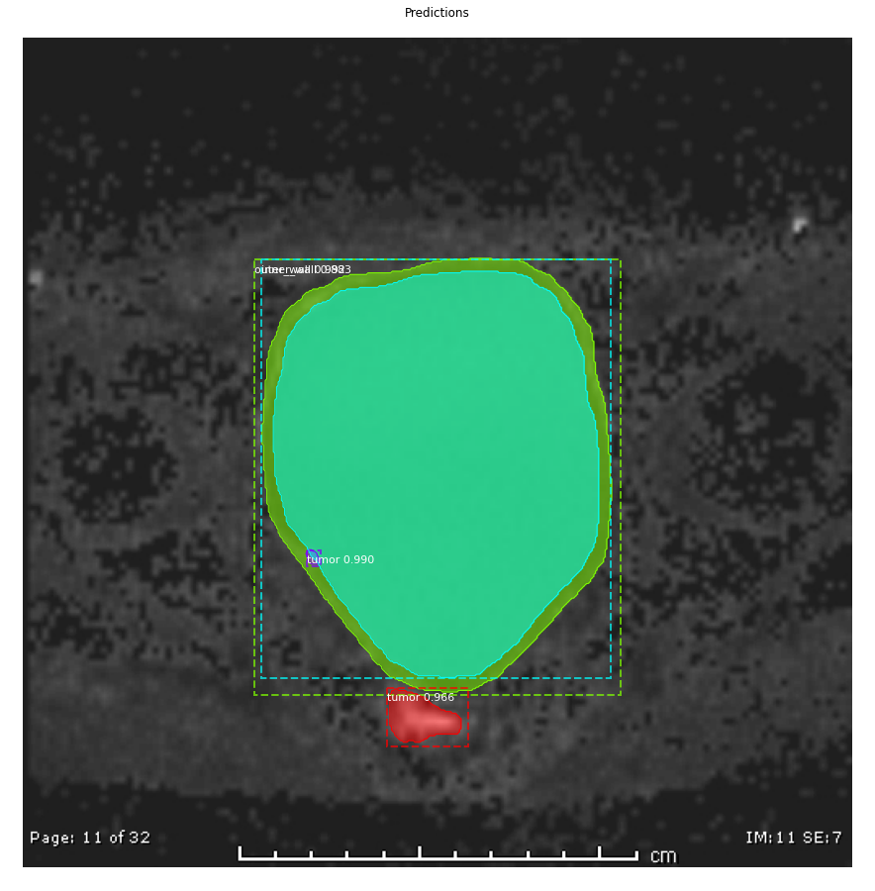
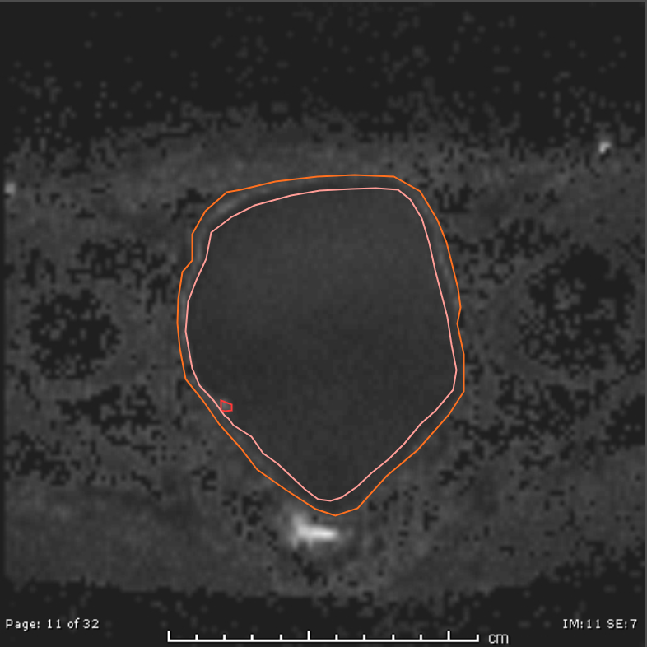
Lesion with VIRADS - 1
Notes:
The left image is the ground truth annotated by Dr. Mustafa Nalbant. Image in the right hand side is the result of the mask rcnn segmentation. In VIRADS -1, muscle invasion is highly unlikely
tumor area does not expand inside the wall borders.

Slide 14
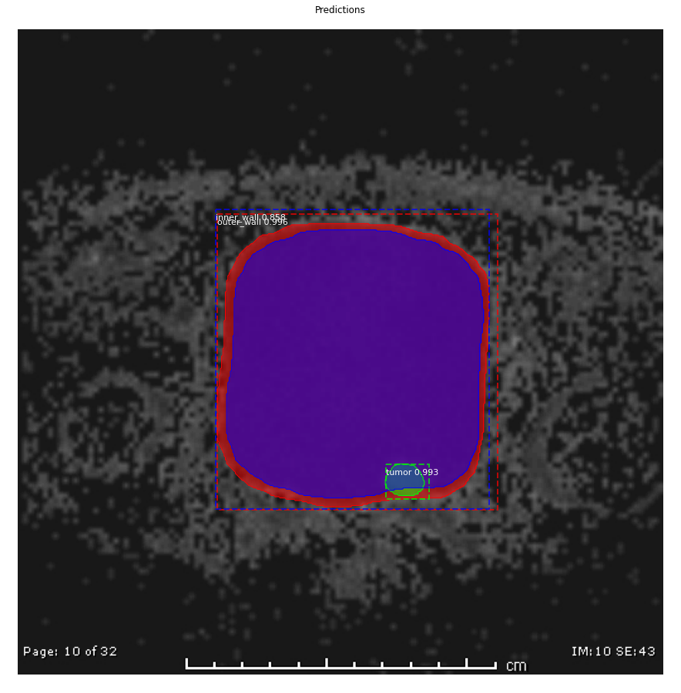
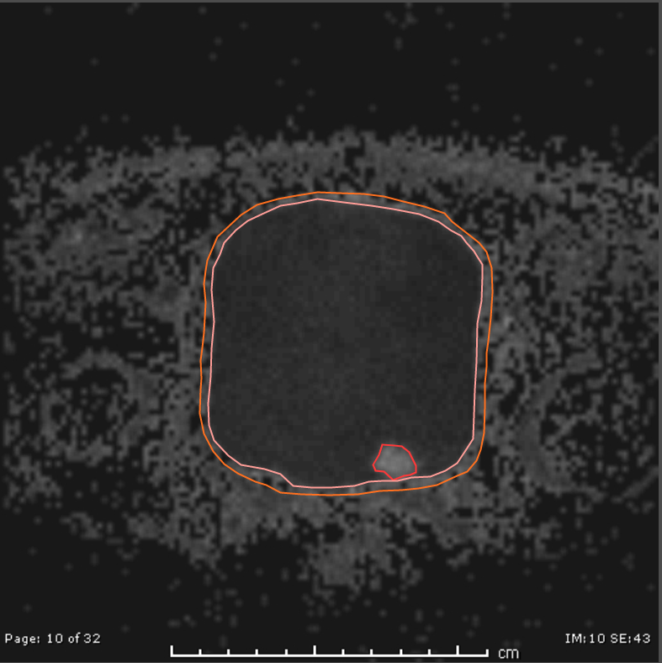
Lesion with VIRADS - 2
Notes:
In VIRADS - 2, tumor area is still inside the bladder. however, mask rcnn segmentation could not exactly detect the wall borders and this cause an tumor expansion inside th wall borders.

Slide 15
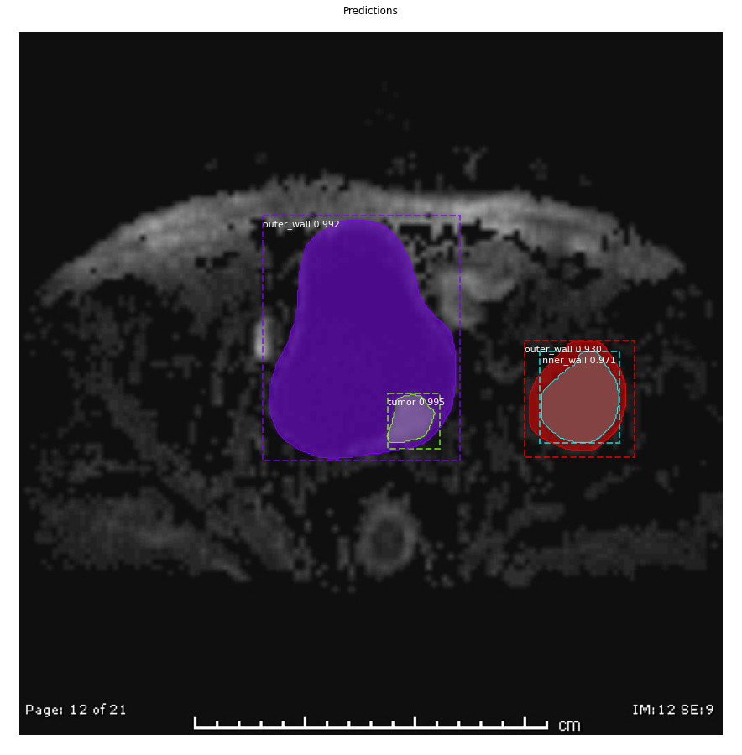
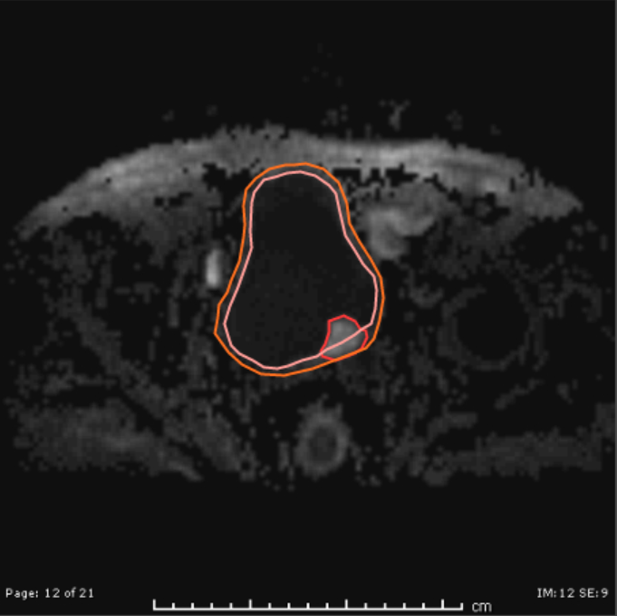
Lesion with VIRADS - 4
Notes:
In VIRADS- 4, tumor area expands inside the bladder wall. In this example, Mask rcnn segmentation detected wrong wall borders outside the bladder because there is a field in this mri which really looks like a bladder.

Slide 16
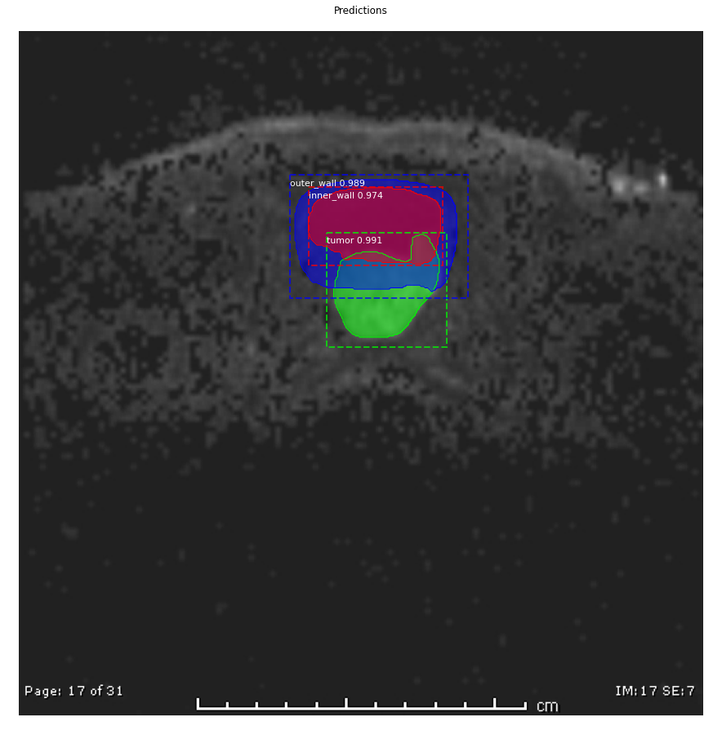
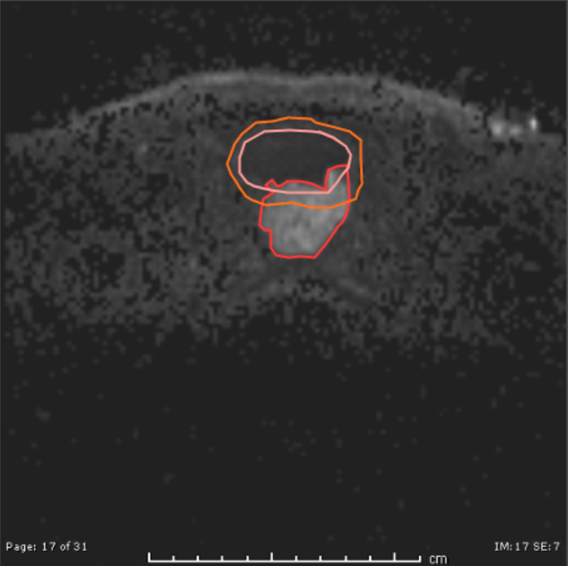
Lesion with VIRADS - 5
Notes:
In VIRADS - 5, tumor area expands outside the bladder and metastasized to other organs. Mask rcnn segmentation is successful in this image.

Slide 17
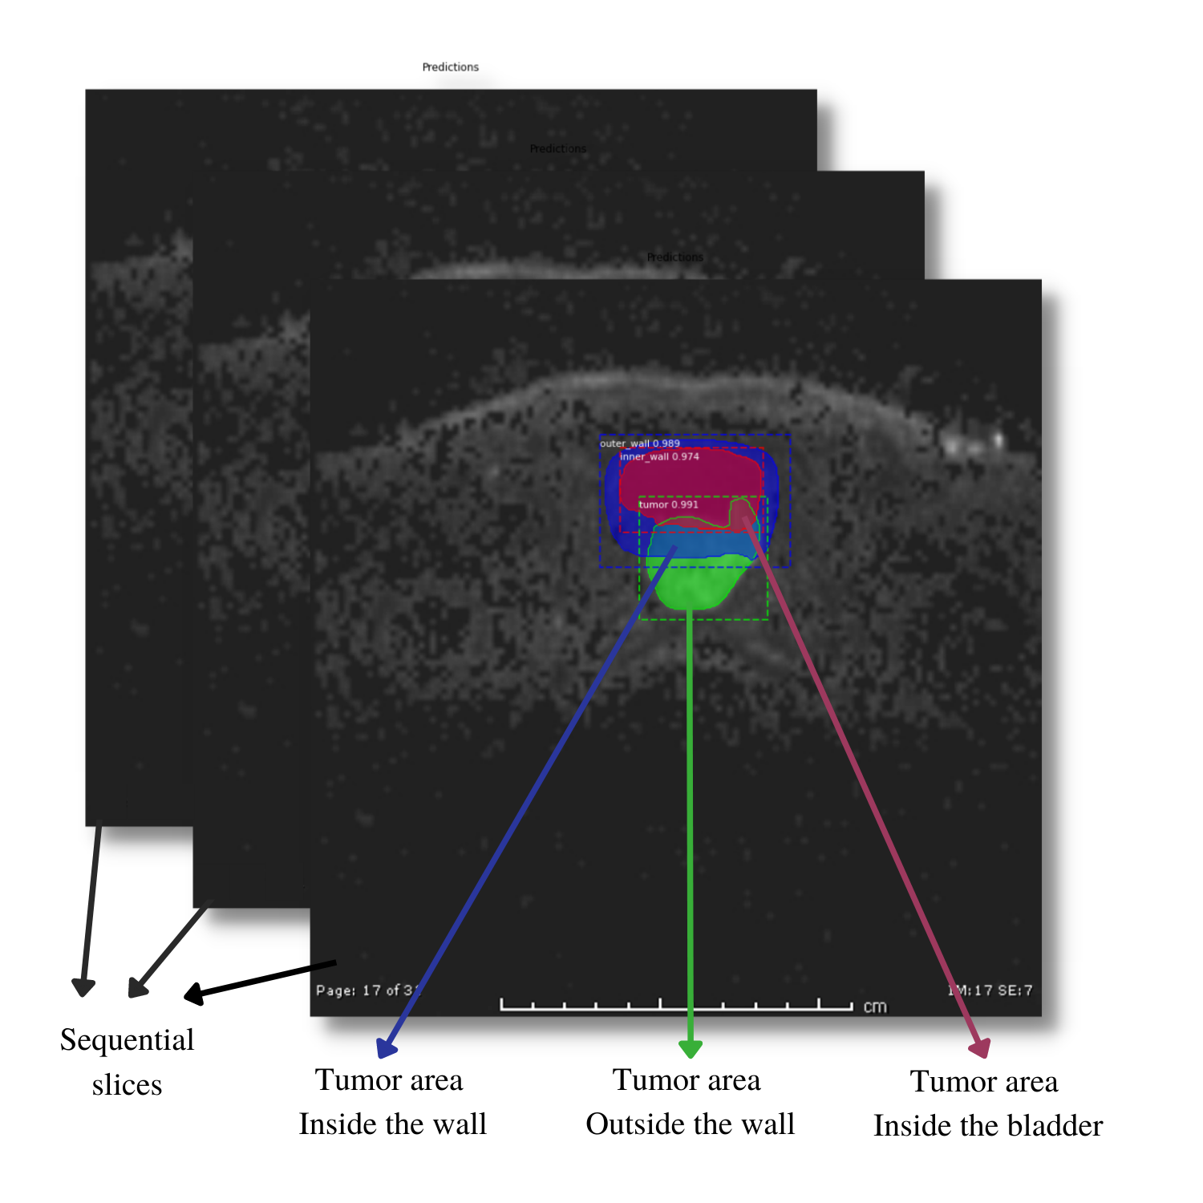
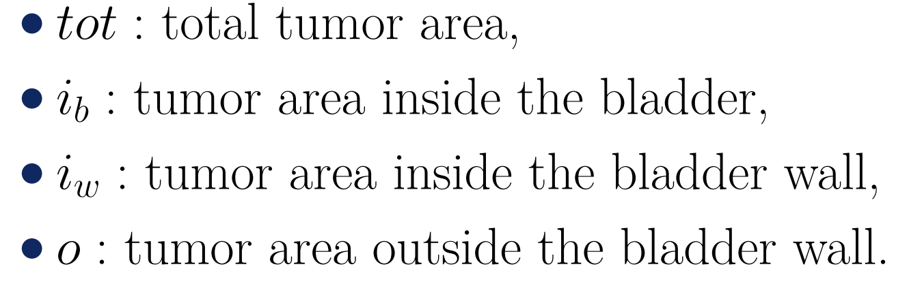
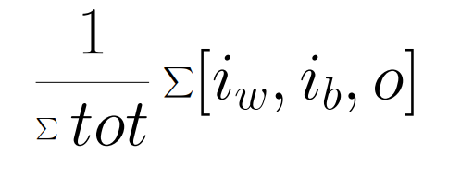
Classification Features
Notes:
Initially we tried 3D reconstruction and image based classification algorithms. however bladder mris are really hard to evaluate with this methods because bladder is not a solid organ and this can cause inhomogenity and disturbance between images. So we decided to extract some features by hand. In diagnosis step, radiologists look for the tumor area as if it expanded to the wall or beyond. We used this strategy and calculate the volumes of tumors inside the bladder, inside the bladder wall and outside the bladder wall. Then we used these features to train classifiers.

Slide 18
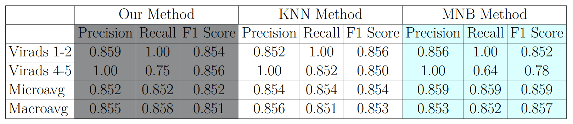
Results with Ground Truths
Notes:
As you can see from the table, the results from ground truths are convincing. Precision and recall rates are really high for both classes. This shows that our feature extraction methodology is working.

Slide 19
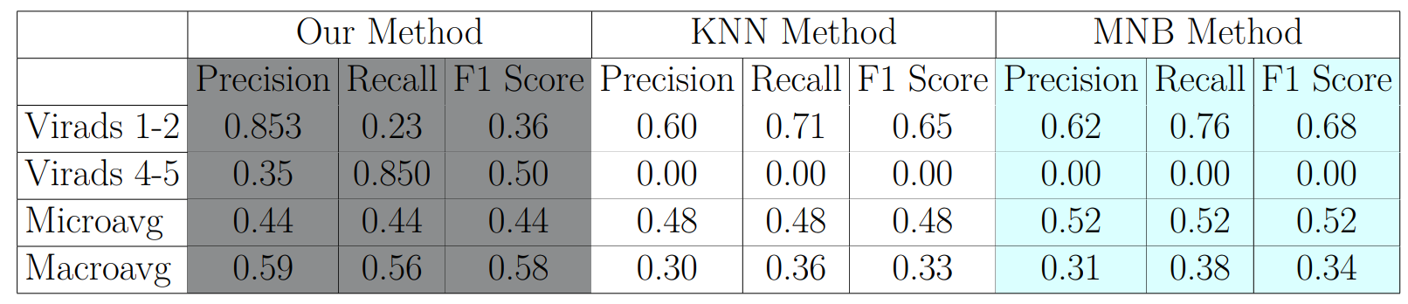
Results with Mask RCNN Segmented Images
Notes:
However, the mask rcnn segmented images did not resulted well. This situation is the result of wrong segmentation of tumors in virads 1 and 2 classes. They are segmented as if they expanded to the bladder walls. We did not have much data from VIRADS 4 and 5 classes and this may be an another reason of underfitting in 4 and 5 class.

Slide 20
Future Work
The dataset of 50 patients is not enough to represent all VIRADS classes. There are only 10 patients with VIRADS 4 and 5 in this dataset. This may cause underfitting.
The amount of data should be increased to reach more accurate classification results.
The successful results of the ground truths show that the methodology is promising and open to progress.
This project can be improved with the addition of new data and fine tuning of the segmentation algorithm.

Slide 21
Acknowledgement
We would like to express our special thanks to Dr. Mustafa Orhan Nalbant and Dr. Rüştü Türkay for their precious efforts in the creation of the dataset and for sharing their knowledge.
We are grateful to Pınar Yanardağ and Suzan Üsküdarlı for guiding us with their experiences and for the time they have devoted to us.

Slide 22
References
Guest Blog: All You Need To Know About Bladder Cancer
Bladder Cancer: Stages, Symptoms, Treatment & Tests
T2 weighted image | Radiology Reference Article | Radiopaedia.org
Diffusion-weighted imaging | Radiology Reference Article | Radiopaedia.org
Vesical Imaging-Reporting and Data System (VI-RADS) | Radiology Reference Article | Radiopaedia.org
"Magnetic Resonance Imaging". University of Wisconsin. Archived from the original on 2017-05-10.
https://www.ncbi.nlm.nih.gov/pmc/articles/PMC5832385/#:~:text=Multiparametric%20MRI%20(mpMRI)%20can%20be,MR%20spectroscopy%20(MRSI)%20images.
Kaiming He, Georgia Gkioxari, Piotr Dollár, and Ross Girshick. Mask r-cnn, 2018
Bladder cancer - Symptoms and causes - Mayo Clinic
Notes:
Thank you for listening us.

